Slide 1
Creating object and classes
Python is an object-oriented language. In python everything is object i.e int , str , bool even modules, functions are also objects.
Object oriented programming use objects to create programs, and these objects stores data and behaviors.
Unlike procedure oriented programming, where the main emphasis is on functions, object oriented programming stress on objects.
We can think of class as a sketch (prototype) of a house. It contains all the details about the floors, doors, windows etc. Based on these descriptions we build the house. House is the object.
As, many houses can be made from a description, we can create many objects from a class. An object is also called an instance of a class and the process of creating this object is called instantiation.

Slide 2
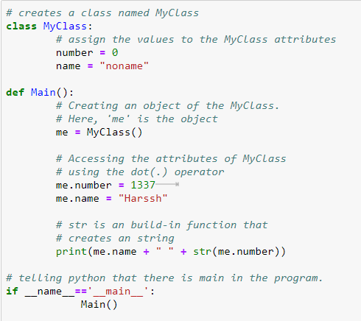

Slide 3
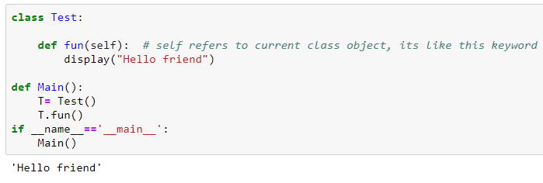

Below is a simple Python program that creates a class with single method.
Next, we create an object/instance of this class using the name of the class followed by a pair of parentheses.

Slide 4
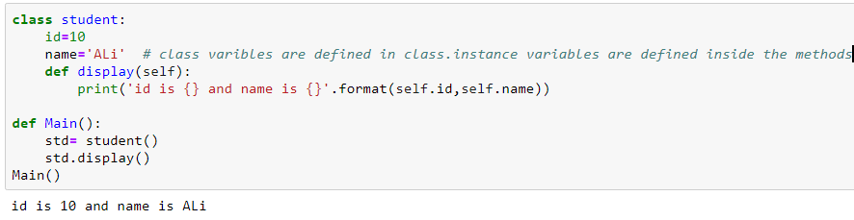

Slide 5
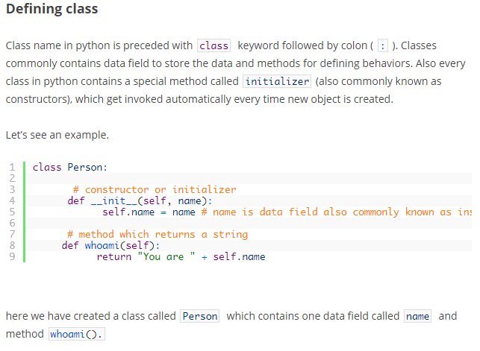

Slide 6
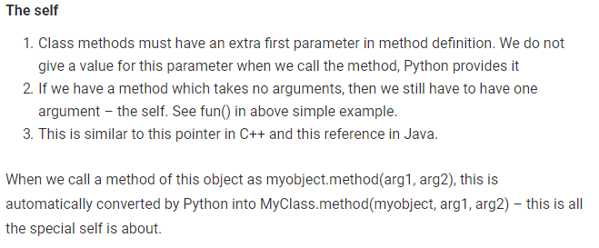
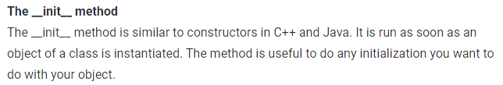

Slide 7
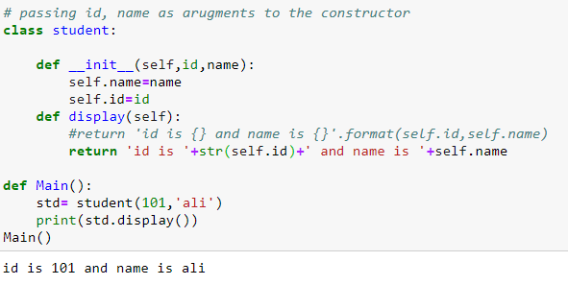
Self is automatically set to the reference of current class object which invoked the method

Slide 8
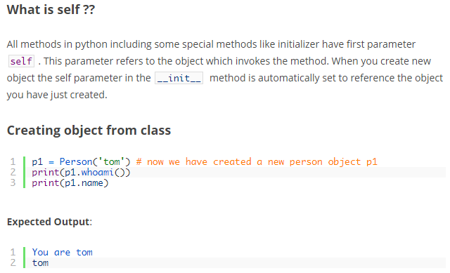

Slide 9
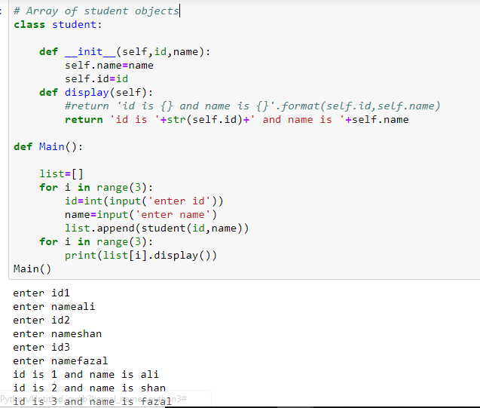

Slide 10
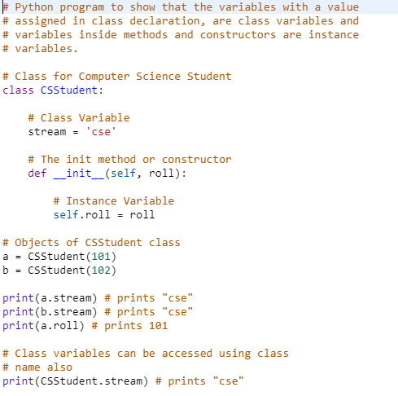
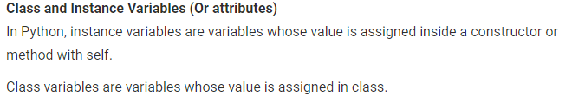

Slide 11
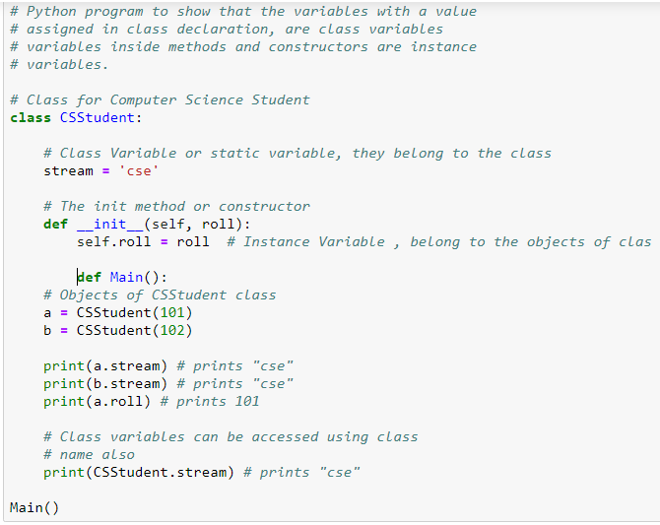

Slide 12
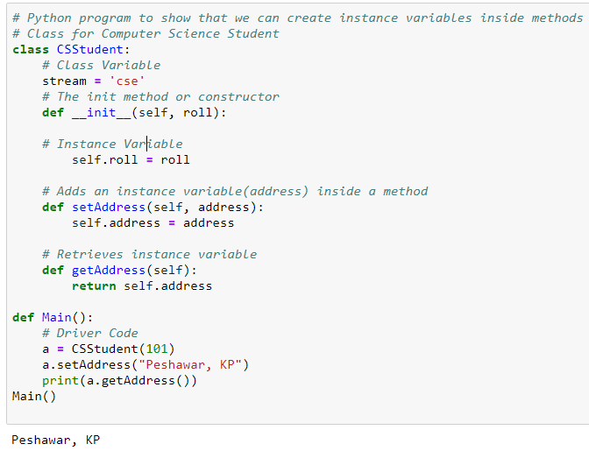
We can define instance variables inside normal methods also.

Slide 13

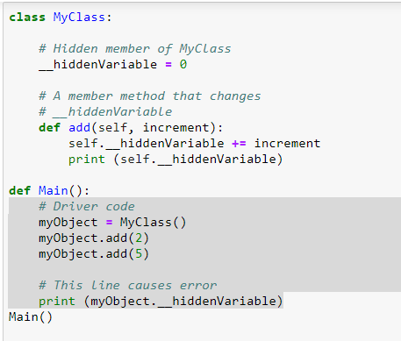

Slide 14
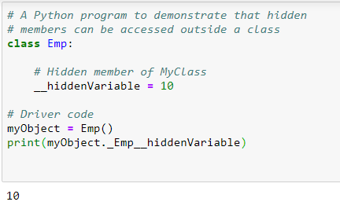
How to create an empty class? We can create an empty class using pass statement in Python.
# An empty class
class Test:
pass

Slide 15
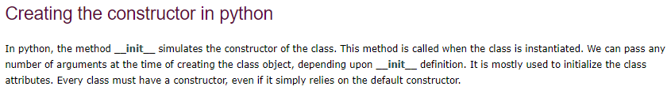
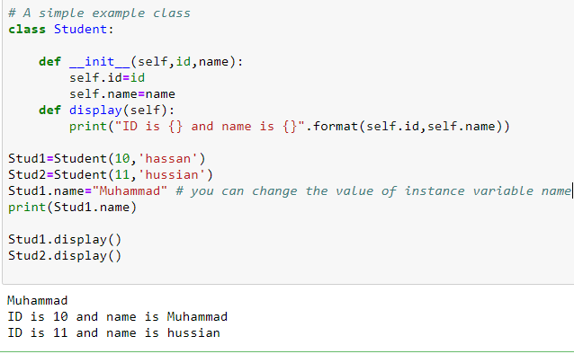

Slide 16
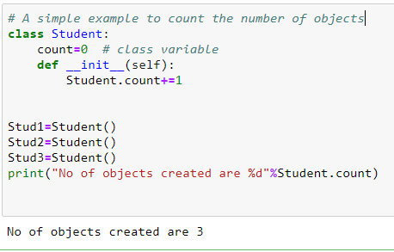

Slide 17
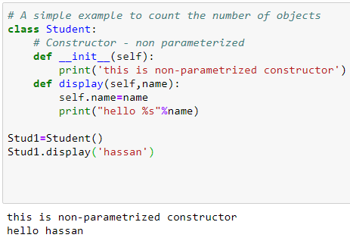
Python Non-Parameterized Constructor Example

Slide 18
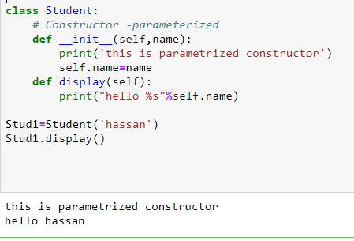
Python Parameterized Constructor

Slide 19
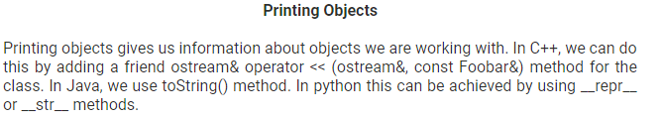
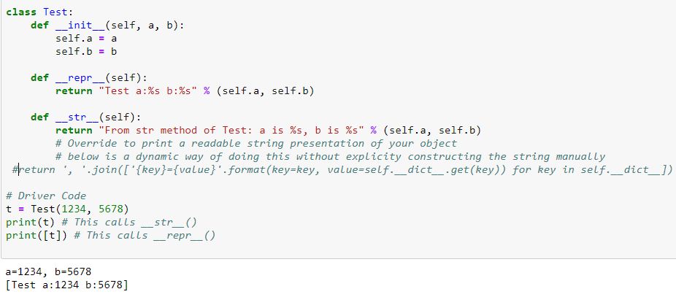

Slide 20
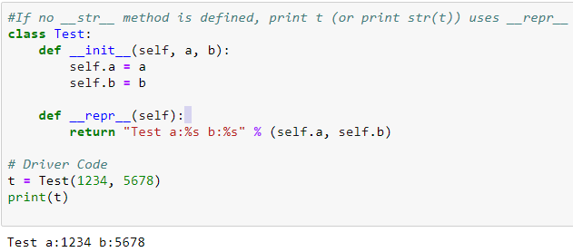
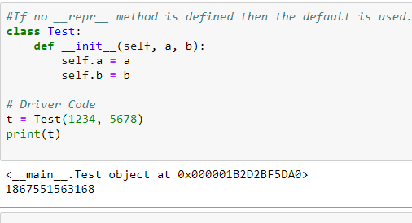

Slide 21
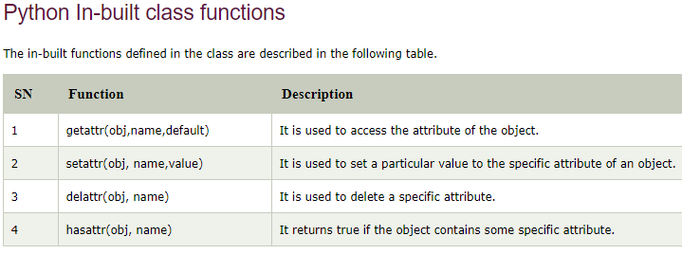

Slide 22
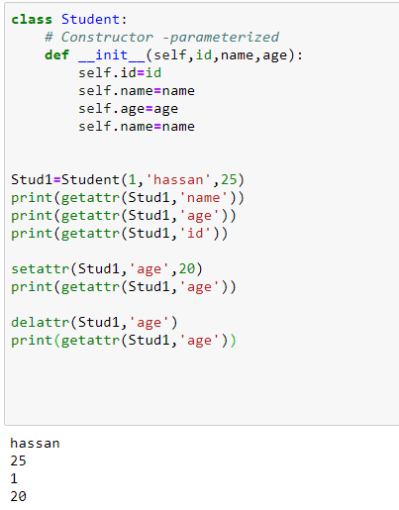
Def Main():
Main()

Slide 23
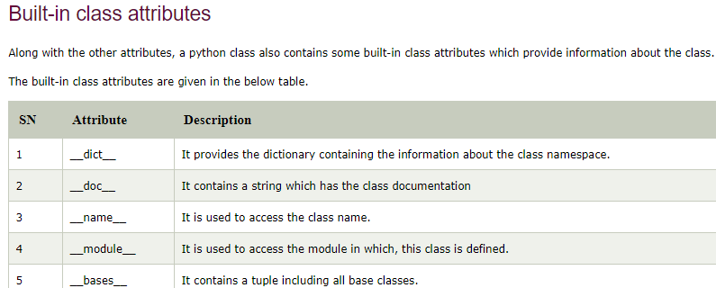

Slide 24
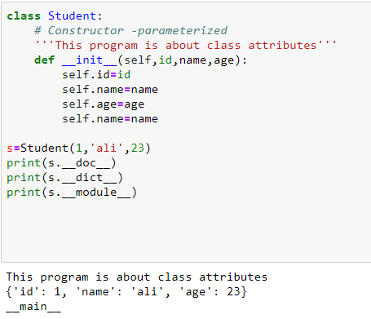

Slide 25
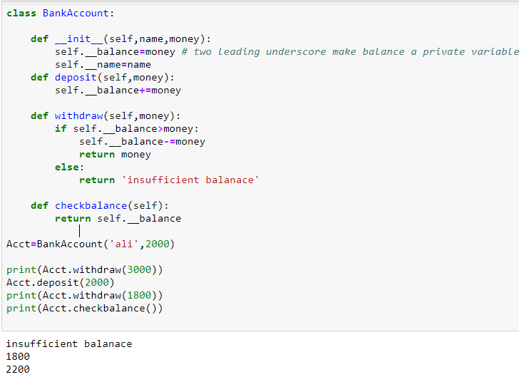
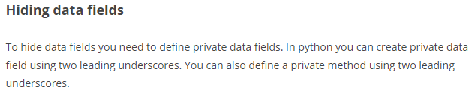
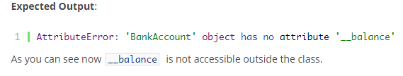

Slide 26
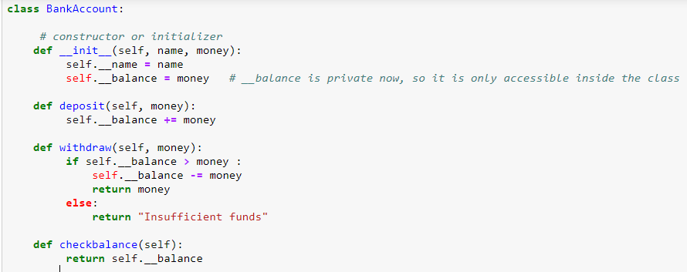

Slide 27
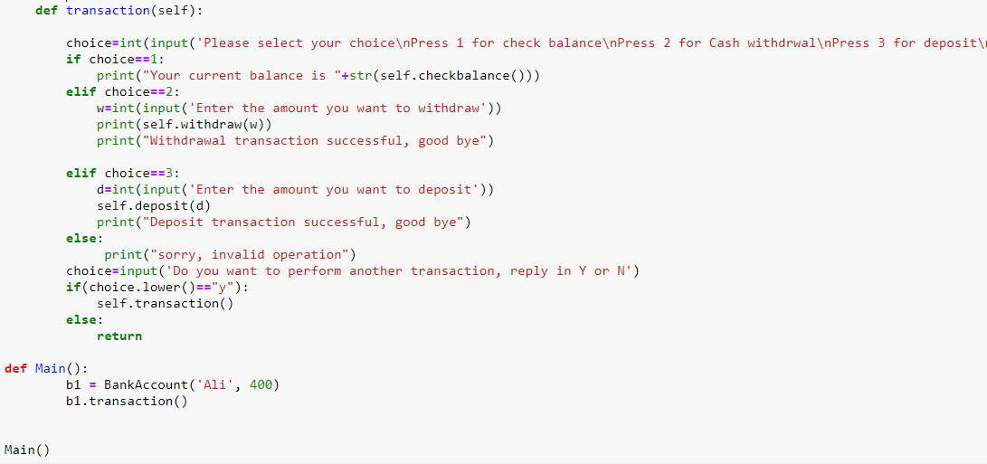

Slide 28
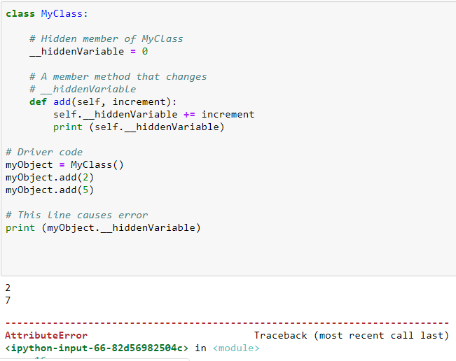

Slide 29
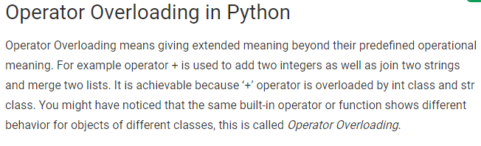
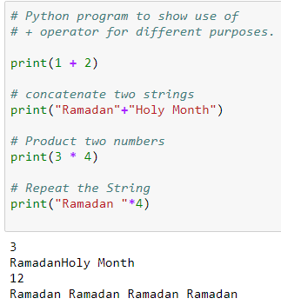

Slide 30
How to overload the operators in Python?
Consider that we have two objects which are a physical representation of a class (user-defined data type) and we have to add two objects with binary ‘+’ operator it throws an error, because compiler don’t know how to add two objects.
So we define a method for an operator and that process is called operator overloading.
We can overload all existing operators but we can’t create a new operator.
To perform operator overloading, Python provides some special function or magic function that is automatically invoked when it is associated with that particular operator. For example, when we use + operator, the magic method __add__ is automatically invoked in which the operation for + operator is defin
Changing the behavior of operator is as simple as changing the behavior of method or function.

Slide 31
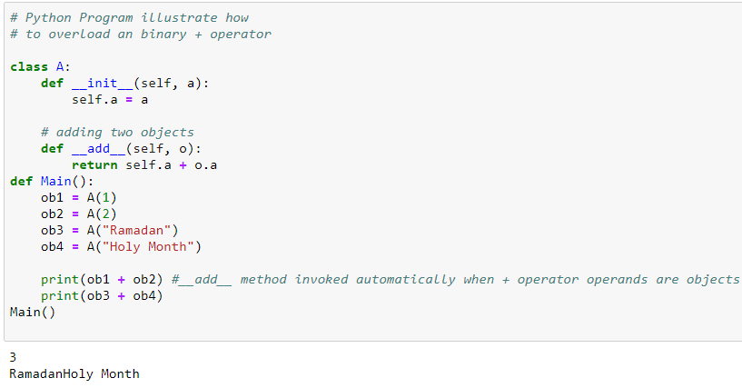

Slide 32
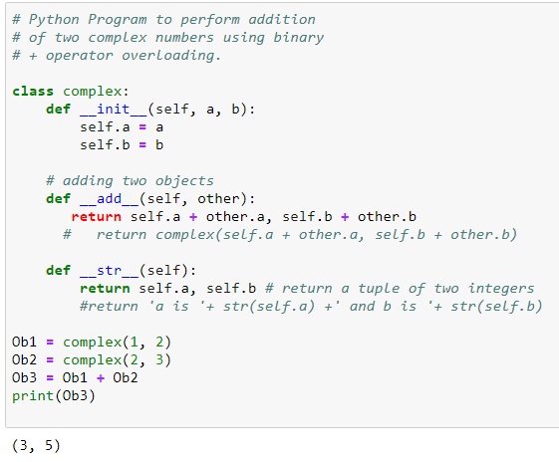

Slide 33
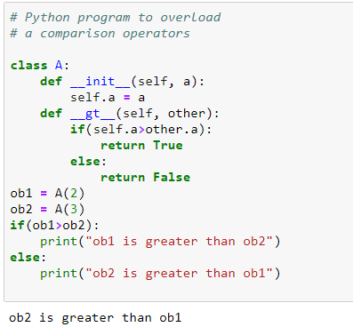

Slide 34
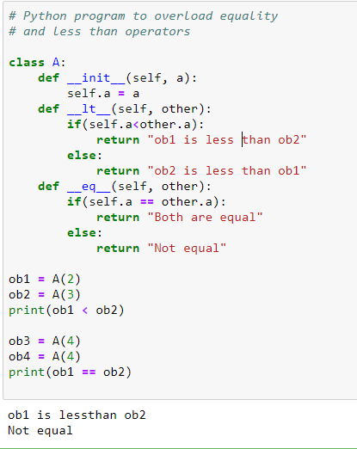

Slide 35
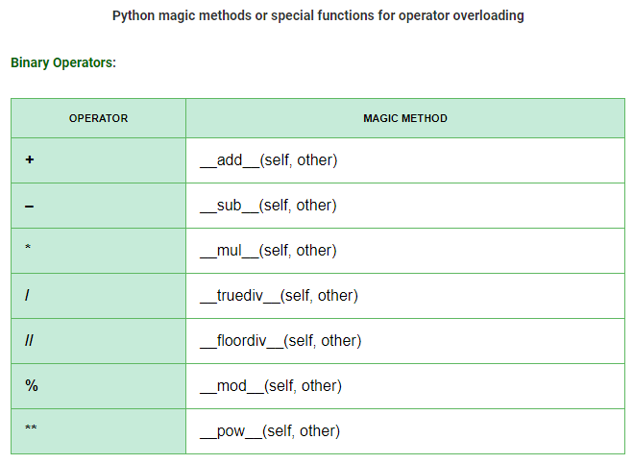

Slide 36
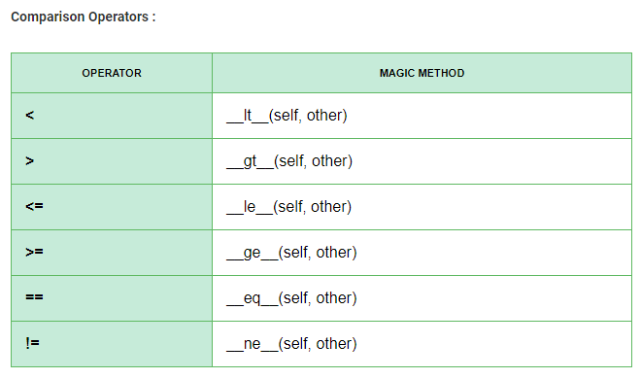

Slide 37
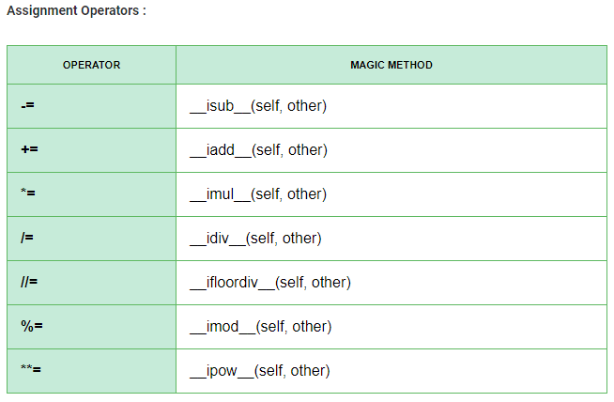

Slide 38
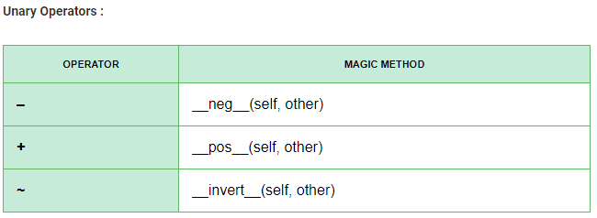

Slide 39
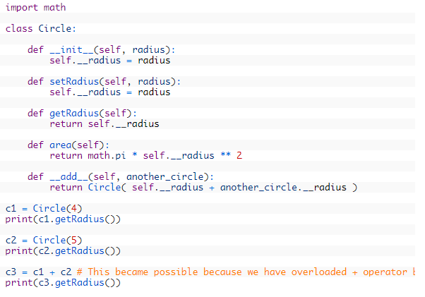

Slide 40
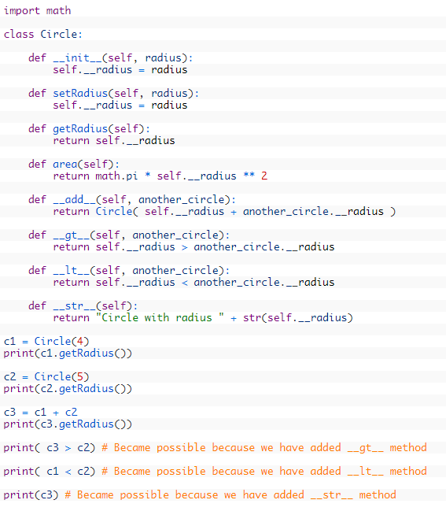

Slide 41
Python Inheritance
Inheritance is an important aspect of the object-oriented paradigm. Inheritance provides code reusability to the program because we can use an existing class to create a new class instead of creating it from scratch.
In inheritance, the child class acquires the properties and can access all the data members and functions defined in the parent class.
A child class can also provide its specific implementation to the functions of the parent class.
In python, a derived class can inherit base class by just mentioning the base in the bracket after the derived class name. Consider the following syntax to inherit a base class into the derived class.

Slide 42
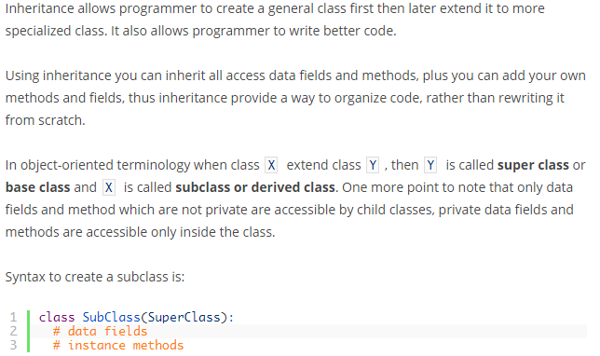

Slide 43
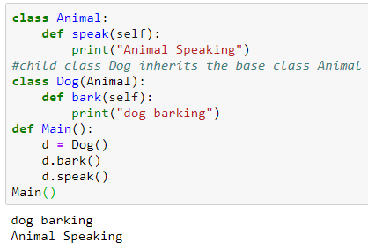

Slide 44
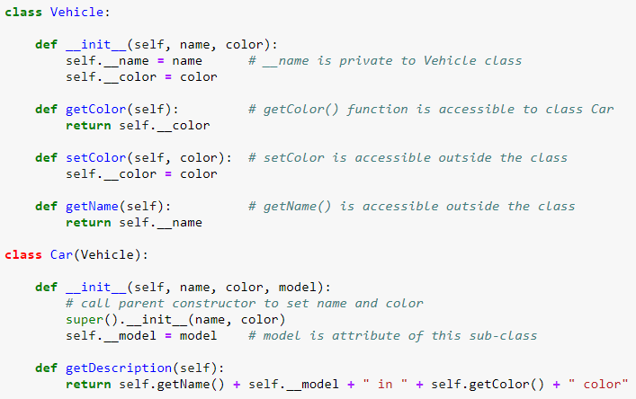

Slide 45
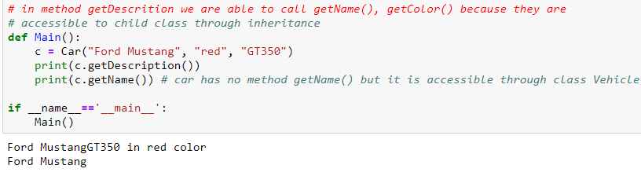


Slide 46



Slide 47


Slide 48



Slide 49



Slide 50


Slide 51



Slide 52


Slide 53



Slide 54


Slide 55


Slide 56


Slide 57

Real Life Example of method overriding

